Slide 1


Group work on Medical IR
Georgios Peikos, Wojciech Kusa, Annisa Maulida Ningtyas

Slide 2
Agenda
Introduction of Information Extraction
Information Extraction Related Task
Health Ontology
MedCAT – Medical Concept Annnotation Tool

Slide 3
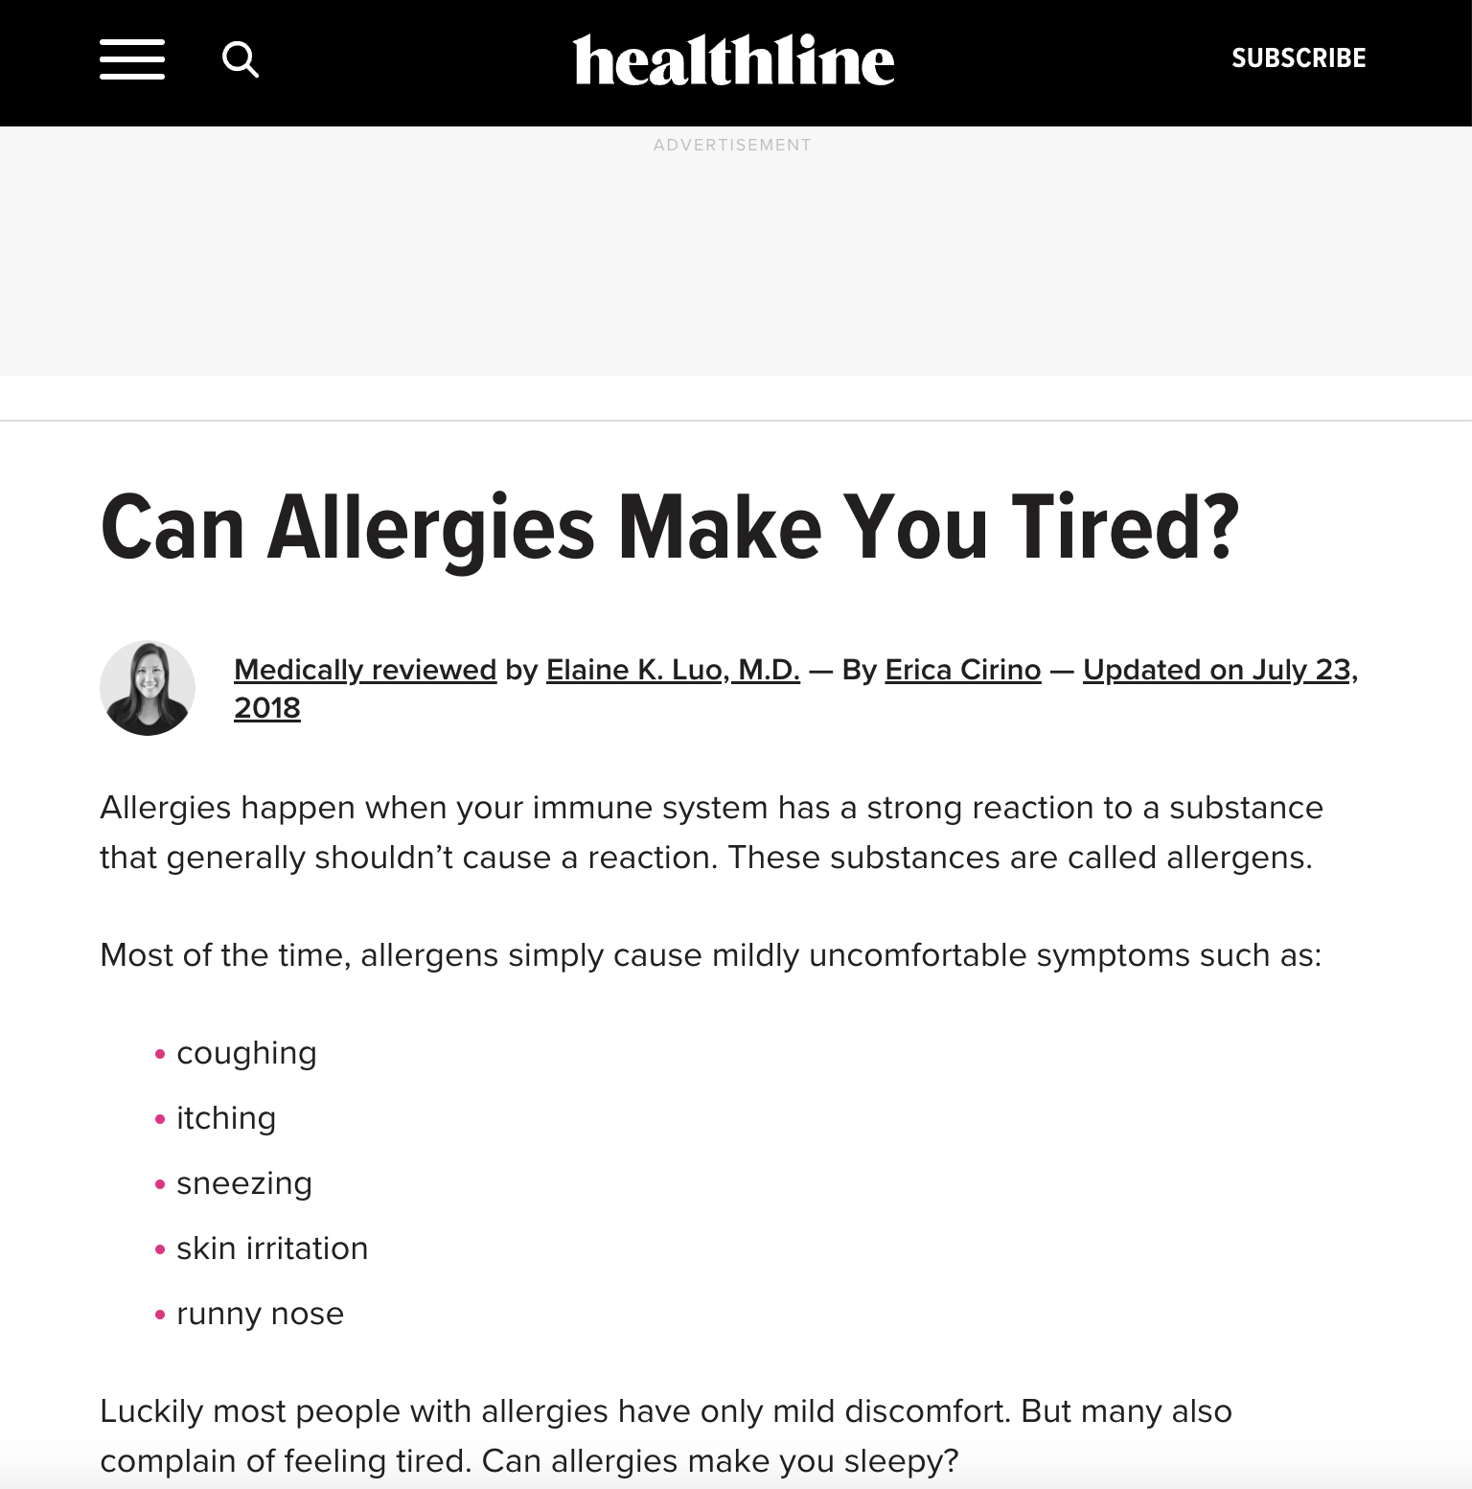
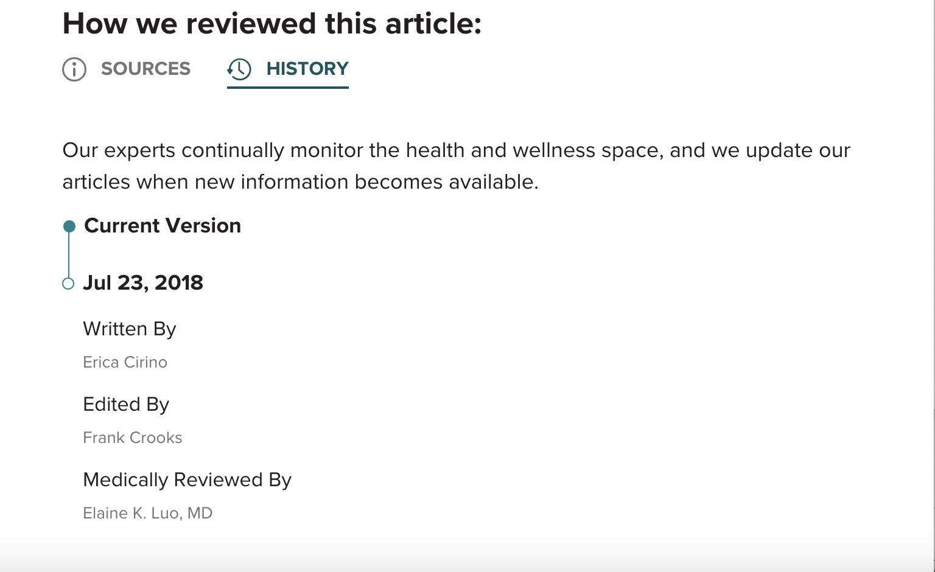
From unstructured to structured form
Allergies could makes fatigue
Author: Erica Cirino
Reviewer: Elaine K. Luo MD
Notes:
So, first thing first, what is information extraction?
Let’s start with thinking about this webpage. This article talks about allergies could make us feel tired. From this article, we want to get this information or to get this fact saying that allergies could makes fatigue.
But, that’s not all, we can know that this article was written by Erica Cirino, and it was reviewed by Elaine K. Luo MD. This article was writtne on Jul 23rd 2018. So, there are all these pieces of information that are all in the article. But they don’t specifically highlighted that allergies could makes fatigue, or written by Erica Cirino ans so on.

Slide 4
What is Information Extraction?
Information Extraction – identify and extract instances of fields of interest from unstructured or semi-structured text and convert to structured representation
Field of interest could be named entities, relations, or events
Known by many others name - named entity extraction, knowledge base population, attribute extraction, ..
Notes:
So, the task of converting information from unstructured text to structured format is one of form information extraction. So, from the article or other texts corpora and leading to pieces of information that we want to pull out in the article is the the basis of information extraction.
Identifying and extractiong instances of interest of unstructured or semi-unstructured text and converting to structured representation. The field of interest could be named entity, or relations, or events, and so on.
What are named entities? Named entites is a thing that have a particular name, such as person name, organization name, location names, and so on.
Infomration extraction also knonw ba many other names, such as named entity recognition, knowledge base population, attribute extraction and so on.

Slide 5
Information Extraction Related Tasks
Identify medical concepts: Named Entity Recognition (NER)
`chest pain`
Identify medical concepts link to medical KB: Medical Concept Normalization
`chest pain` - ´chest pain (SCUI: 29857009)`
`MRI` - `Magnetic Resonance Imaging (SCUI: 113091000)`
Identify relationships between concepts: Relationship Extraction
Treats(Prozac, clinical depression)
Causes(cataract, decreased vision)
Extract assertions, attributes values
Blood pressure: high, low, normal
Tumor: absent, benign, malignant, in-situ, un-known
Identify protected health information: De-identification
Patient name, clinician’s name
DoB, Date of clincal encounter
`MRI`
Notes:
And now we will explain about the information extraction related tasks.
If we look on specific in medical concepts, we could called as that medical concept named entity recognition or named entity recognition in medical field. For example that would something like chest pain, or MRI.
If we would like standardize each of medical entities to formal medical terminology in knowledge base, such as Chest pain to chest pain. Here unfortunately has the same name of medical terminology, or for MRI, we normalize to Magnetic Resonance Imaging. We called as this task as Medical Concept Normalization, or medical entity linking, and so on.
You could be asked to identify relationships between concepts. This would typically be co-relation identification. Example would be Prozac treats clinical depression, so there is a relationship between Prozac,
one entity and clinical depression, the other entity, and the relationship is treating, or cataract causes decreased vision. Again, it's a relationship of two entities; cataract and decreased vision.
You could be extracting assertions or attribute values. This generally is called information extraction. Assertions would be something like blood pressure could be high, low, or normal. A tumor could be absent,
benign, malignant, institute, or unknown. These are different attribute values for the variable tumor. If tumor is present, then is it benign or malignant?
If you are identifying a certain class of medical entities called protected health information that task would then be called the identification, because you are identifying all personally identifiable information, such as a person's name or a date of visit in a clinic, and removing that, you're de-identifying those documents. So patient's name, clinician's name, date of birth, date of clinical encounter, and so on would all be fields of interest in a protected health information.

Slide 6
Information Extraction Related Tasks
Identify medical concepts: Named Entity Recognition (NER)
`chest pain`
Identify medical concepts link to medical KB: Medical Concept Normalization
`chest pain` - ´chest pain (SCUI: 29857009)`
`MRI` - `Magnetic Resonance Imaging (SCUI: 113091000)`
Identify relationships between concepts: Relationship Extraction
Treats(Prozac, clinical depression)
Causes(cataract, decreased vision)
Extract assertions, attributes values
Blood pressure: high, low, normal
Tumor: absent, benign, malignant, in-situ, un-known
Identify protected health information: De-identification
Patient name, clinician’s name
DoB, Date of clincal encounter
`MRI`
Notes:
In this working session, we would like to focused on medical named entity recognition and linking to medical knowledge base.

Slide 7
An Example: Find all medical concepts
The patient is a 63-year-old female with a three-year history of bilateral hand numbness and occasional weakness.
Within the past year, these symptoms have progressively gotten worse, to encompass also her feet.
She had a workup by her neurologist and an MRI revealed a C5-6 disc herniation with cord compression and a T2 signal change at the level
Notes:
Let’s take a look a this passage, and we will identify the medical entities. Let’s me read the passage. The patient is a 63-year-old female with a three-year history of bilateral hand numbness and occasional weakness.
Within the past year, these symptoms have progressively gotten worse, to encompass also her feet. She had a workup by her neurologist and an MRI revealed a C5-6 disc herniation with cord compression and a T2 signal change at the level
Clearly, examples like bilateral hand numbness or occasional weakness or C5-6 disc herniation and so on are all relevant medical concepts because they're talking about different things that
are happening to this patient. In addition, there were certain tests that were done. You have a workup or MRI, which are also relevant entities. she's also seeing different specialists.
In this case, neurologist, and that mention is also relevant.
In this task, we need to decide what concepts are interest.

Slide 8
Relevant entities in medical record
Disease: symptoms, problems, signs, conditions
Treatment: medication, surgery, procedure, follow-up
Test: blood work, lab work
Anatomical sites: body parts, regions,
Chemical agent: drugs, substance, ..
…….
Notes:
In general, in a medical concept the relevant entities are diseases, so signs and symptoms, problems, conditions and so on. They could be treatment. For example, medication and surgery and procedures and follow-up. There will be tests that were done on the patient. There are some body parts that I mentioned or regions of the body or other things like drugs and so on.

Slide 9
Health Ontology – SNOMED CT
SNOMED CT is a clinical terminology
Systematized Nomenclature of Medicine (Clinical Terms)
Collection of names and words
Relevant to the field of medicine
Organised in a structured and logically consistent manner
Standardized, multilingual vocabulary of clinical terminology used for electronic exchange of clinical health information
More ‘like’ a thesaurus than just a coding scheme
Notes:
So….
You could say that for users of systems with SNOMED CT it is more like a thesaurus. A collection of medical words grouped together in a logical way, with a number of ways of expressing the same clinical thought.

Slide 10
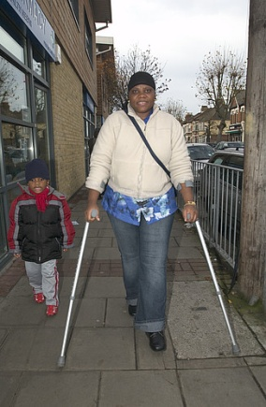
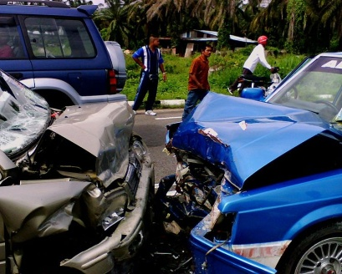
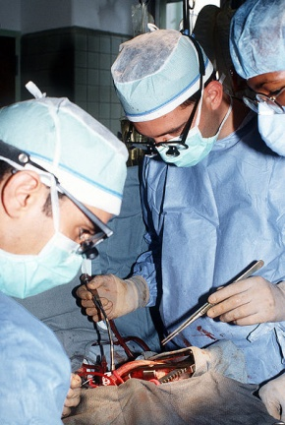
SNOMED CT Content
Clinical Findings
Disease and deformity – scar
Symptoms – difficulty breathing
Causes of Disease
Forces – pressure change
Events – road traffic accident
Procedures
Laboratory
Therapy
Examination findings – tachycardia
Organisms – herpes simplex virus
Surgical procedure
Social – finding of walking aid use
Clinical Investigation
Notes:
These two slides give a general overview of what sort of content is in SNOMED CT and how SNOMED CT is structured. There are 19 hierarchies in SNOMED CT and rather than go through each one individually this puts them in groups to give you a feel for the type of coverage of content. If you require more detailed information about the hierarchies it can be found on our website.
So on this slide we have
Clinical findings which includes areas such as diseases, symptoms and examination findings
Causes of disease includes areas such as forces, events and organisms
Procedures are pretty self explanatory but include items such as operations, investigations and therapies

Slide 11
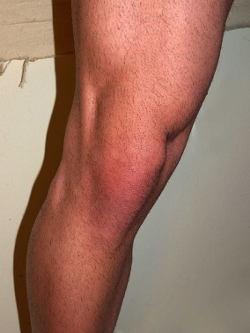

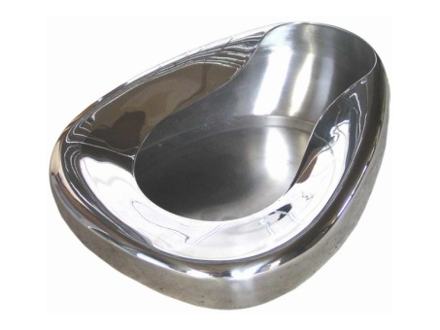
SNOMED CT Content
Anatomy
Normal – knee joint
Abnormal – ganglion cyst
Observations
Vital signs – blood pressure
Body product observable – colour of urine
Products
Drugs – paracetamol
Substances – latex
Devices – bedpan
Lesions – bony callus
Values - present
Notes:
On this slide we look at
Anatomy which includes both normal and abnormal anatomy
Observations include items such as vital signs and values
And finally products include devices and drugs, that is the drugs we are familiar with together with the individual ingredients that go to make up those drugs

Slide 12
A Concept in SNOMED CT
Codes and descriptions
Relationships
Is a
Qualifiers & values
Attributes
Notes:
A concept is identified by its code and descriptions but it also has relationships which establish what kind of concept it is (e.g. Clinical finding, procedure) and these relationships further define the concept to give us more information about it such as finding site (concept pneumonia has finding site of lung structure) and laterality (left or right)

Slide 13
A Concept in SNOMED CT
Preferred Term: Heart Disease
Synonym: Cardiopathy
Synonym: Disorder of Heart
Synonym: Morbus Cordis
Synonym: Cardiac Disorder
Synonym: Cardiac Diseases
Synonym: Heart Diseases
Heart disease (disorder) 56265001
Relationships
Is a cardiac finding
Is a disorder of mediastinum
Is a disorder of cardiovascular system
Finding site heart structure
Severity
Episodicity
Courses
Notes:
In this example we are looking at heart disease.
We can see the unique human readable form and the unique ID for the concept, but we can also see the Preferred Term, the one that most clinicians use for this disorder together with a list of Synonyms which are different ways of saying the same thing.
We can also see that we are provided with more information about this disorder, we know that it is “a cardiac finding” and “a disorder of cardiovascular system”.
As well as that we can see that it occurs in the heart structure. This can be very useful if you wanted to find all disorders that occur in the heart structure as you could search for disorders with a finding site of heart structure and you wouldn’t need to remember all the disorders.

Slide 14
SNOMED-CT Browser tool
https://browser.ihtsdotools.org/?perspective=full&conceptId1=404684003&edition=MAIN/2021-07-31&release=&languages=en

Slide 15
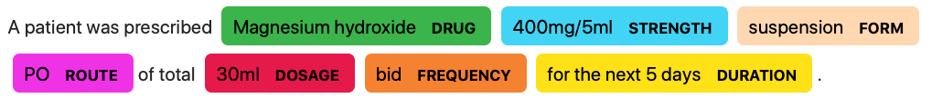
IE Techniques - NER
A patient was prescribed Magnesium hydroxide 400mg/5ml suspension PO of total 30ml bid for the next 5 days

Slide 16
Medical NER Tools
Spacy¹
Scispacy²
METAMAP³
MedCAT⁴
…
¹https://github.com/explosion/spaCy
²https://allenai.github.io/scispacy/
³https://lhncbc.nlm.nih.gov/ii/tools/MetaMap.html
⁴https://github.com/CogStack/MedCAT

Slide 17
MedCAT - Medical Concept Annotation Tool
An open-source NER and Linking (NER+L) and an annotation tool and online learning training interface.
Use to extract information from Electronic Health Records (EHRs) and link it to biomedical ontologies like SNOMED-CT and UMLS.
Zeljko Kraljevic, Thomas Searle, Anthony Shek, Lukasz Roguski, Kawsar Noor, Daniel Bean, Aurelie Mascio, Leilei Zhu, Amos A. Folarin, Angus Roberts, Rebecca Bendayan, Mark P. Richardson, Robert Stewart, Anoop D. Shah, Wai Keong Wong, Zina Ibrahim, James T. Teo, Richard JB. Dobson

Slide 18
MedCAT Workflow
Input text
NER
Entity Linking
Annotated input text
The patient is a 63-year-old female with a three-year history of bilateral hand numbness and occasional weakness.
Bilateral
Hand numbness
Occasional
Weakness
…
Right and left (scui: 51440002)
Numbness of hand (scui: 13791008)
Occasional (scui: 84638005)
Asthenia (scui: 13791008)
…
The patient is a 63-year-old female with a three-year history of bilateral hand numbness and occasional weakness.

Slide 19
MedCAT Demo
https://medcat.rosalind.kcl.ac.uk/

Slide 20
Reference
The content of this slides are taking from coursera course: ‘Information Extraction from Free Text Data in Health’
https://www.coursera.org/learn/information-extraction-from-free-text-data-in-health-2/

